Slide 1
Superstore Sales Dashboard Overview
Insights from Power BI

Slide 2
Introduction
Objective: - To explore the Superstore Sales dashboard and derive actionable insights.
Importance: - Data visualization aids in strategic decision-making.

Slide 3
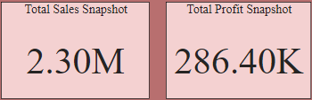
Visuals In Dashboard
1)Card Visuals - Total Sales and Total Profit
Description: - Displays total sales and total profit as key metrics.
- Key Insights: - Quick reference for overall performance, crucial for management reviews.

Slide 4
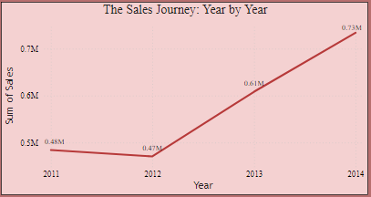
2)Line Chart – The Sales Journey: Year by Year
Description: - Displays total sales trends from year to year.
- Key Insights: - Identify growth trends, seasonal patterns, and peak sales years.

Slide 5
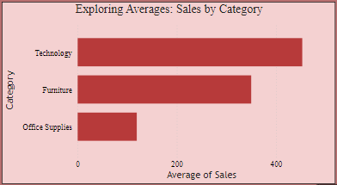
3)Bar Chart – Exploring Averages: Sales by Category
Description: - Shows the average sales for each product category.
- Key Insights: - Highlights categories with the highest and lowest average sales, guiding inventory decisions.

Slide 6
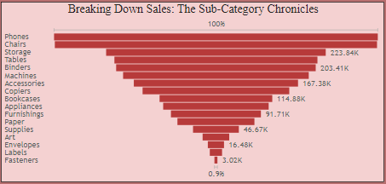
4)Funnel Chart – Breaking Down Sales: The Sub-Category Chronicles
Description: - Visualizes sales volume across subcategories.
- Key Insights: - Assists in identifying strong and weak subcategories, important for targeted marketing.

Slide 7
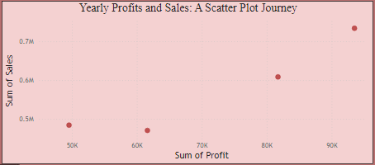
5)Scatter Plot - Sales vs. Profit by Year
Description:
- Correlation between sales and profit over years.
Key Insights:
- Identify relationship trends between sales and profit.

Slide 8
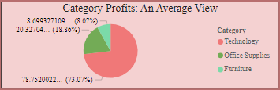
6)Pie Chart - Average Profit by Category
Description: - Illustrates the average profit distribution across categories.
- Key Insights: - Pinpoints which categories contribute most to profitability.

Slide 9
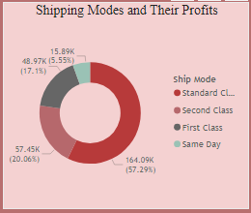
7)Donut Chart - Profit by Ship Mode
- Description:
- Displays profit distribution based on shipping methods.
- Key Insights:
- Understand which shipping modes are most profitable.
- Evaluate shipping strategy for cost-efficiency.

Slide 10
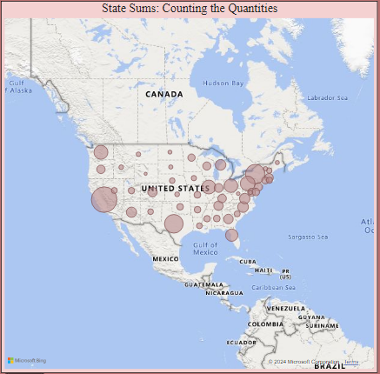
8)Map Chart - Sum of Quantities by States
- Description:
- Geographic representation of quantities sold
- Key Insights:
- Identify strong and weak markets geographically.
- Regional strategies for sales improvement.

Slide 11
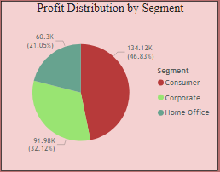
9)Pie Chart - Profit by Segment
- Description:
- Shows how profit is distributed across different customer segments.
- Key Insights:
- Determine which segments are most profitable.
- Target marketing strategies based on profitability.

Slide 12
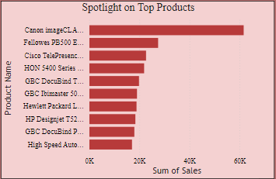
10)Bar Chart - Top Products
Description: - Lists the top-selling products based on total sales.
- Key Insights: - Focus on these products for promotional efforts and inventory management.

Slide 13



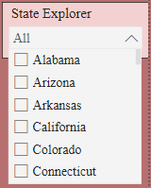
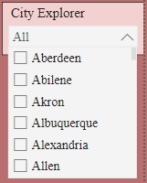
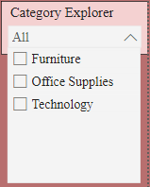
Slicers
Description:
- City name, state name, and category slicers for data filtering.
Purpose:
- Allows users to drill down into specific areas for detailed analysis.
Key Insights:
- Flexibility in data exploration enhances insights.

Slide 14
Conclusion
This Power BI dashboard provides a comprehensive overview of Superstore sales performance, highlighting key metrics such as total sales and profit across various categories and segments. The visualizations reveal trends over time, performance by subcategories, and insights into geographical sales distributions. By leveraging slicers for city, state, and category, users can interactively explore data, allowing for informed decision-making and strategic planning. Overall, the dashboard serves as a valuable tool for analyzing sales dynamics and identifying growth opportunities within the Superstore.

Slide 15
Thank You

